Slide 1
Budget Travel & Phubbing
Essay Writing （Exercise 1&2）

Slide 2
Budget Travel
money-saving
pocket-friendly option
adventurer / adventurous spirit

Slide 3
Good Beginnings
… They draft a budget, book flights before prices skyrocket, live in hostels and even cook by themselves. In this way, travelers get to widen their horizons without burning a hole in their pocket.
蔡英诚
In tourism these days, a new method of traveling, budget traveling, is finding its place. The word ‘budget’ refers to an elaborately designed traveling plan. Budget travelers will search for instructions and decide on their accommodations. In this way, most budget travelers can enjoy traveling with a light financial burden. 曹宇凡

Slide 4
Have you ever dreamed of visiting one place, only to be stopped from realizing it for lack of money? If so, try budget travel. By splitting every penny into two, you can taste the fun of travel with limited budget. 梅天秀
While the world is becoming more and more interlinked, by means of the Internet, the craze for navigating in the physical world has not changed. More and more people are planning their trips down to the cents based on information gathered online. This is called “travelling on a budget”, which enables “budget travelers” to enjoy travelling without much expenses. 牛瑞骐

Slide 5
An Exhilarating Journey
Freedom
Individuality
Local Culture
True Essence of Travel

Slide 6
freedom
budget time and money wisely
freedom from being restricted by a fixed schedule
make timely adjustment
walk or cycle freely instead of being carried here and there by modern vehicles
Budget travel provides a wide range of choices and means greater freedom. Travelers don’t have to wait in a long line for several hours just to get into a packed museum. Conversely, they stop and restart whenever they want. They have the chance to discover unknown spots, which adds a sense of surprise to the trip.
蔡哲飚

Slide 7
individualization
individualized plan/ customized route
use guidebooks to identify the areas most frequented by tourists and then go in the opposite direction
get off the beaten track/ stay away from the tourist trails

Slide 8
local culture
learn more social or religious customs and taboos in person
take a bite of local culture
venture in the lanes and alleys

Slide 9
the essence of travel
Travel is not about entertainment or shopping. It is about the excitement of exploration of a brand-new place, the adaptation to different social conventions and the deeper thoughts about life. Travelling on a budget brings them back by cutting down the funds.
樊君儒

Slide 10
Disadvantages
health issues ---- food safety/ hygiene problems
property safety
accommodation
transportation
Comfort is sacrificed in exchange of freedom.
Situations change regardless of people’s will. What keeps you free also makes you isolated in emergency cases.
卢一骊

Slide 11
Personal Opinion
weigh/compare
outweigh

Slide 12
Life rolls on along with uncertainty and risks. What moves me most is the spirit behind those budget travelers. Though they are less well-off and may be at the bottom of the class rank, they prove it loud to the world that travelling is no longer a luxury limited to the upper class; instead, everyone has equal access to the joy and fun of an excellent journey.

Slide 13
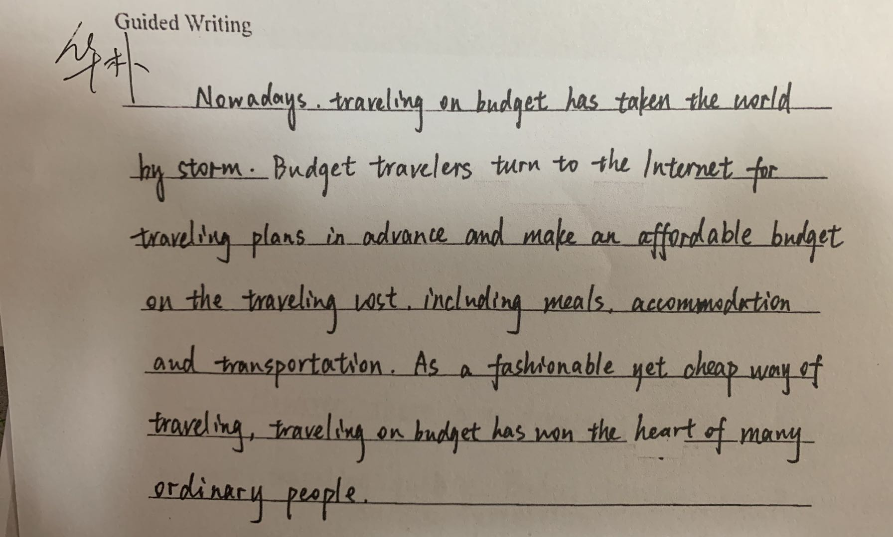

Slide 14
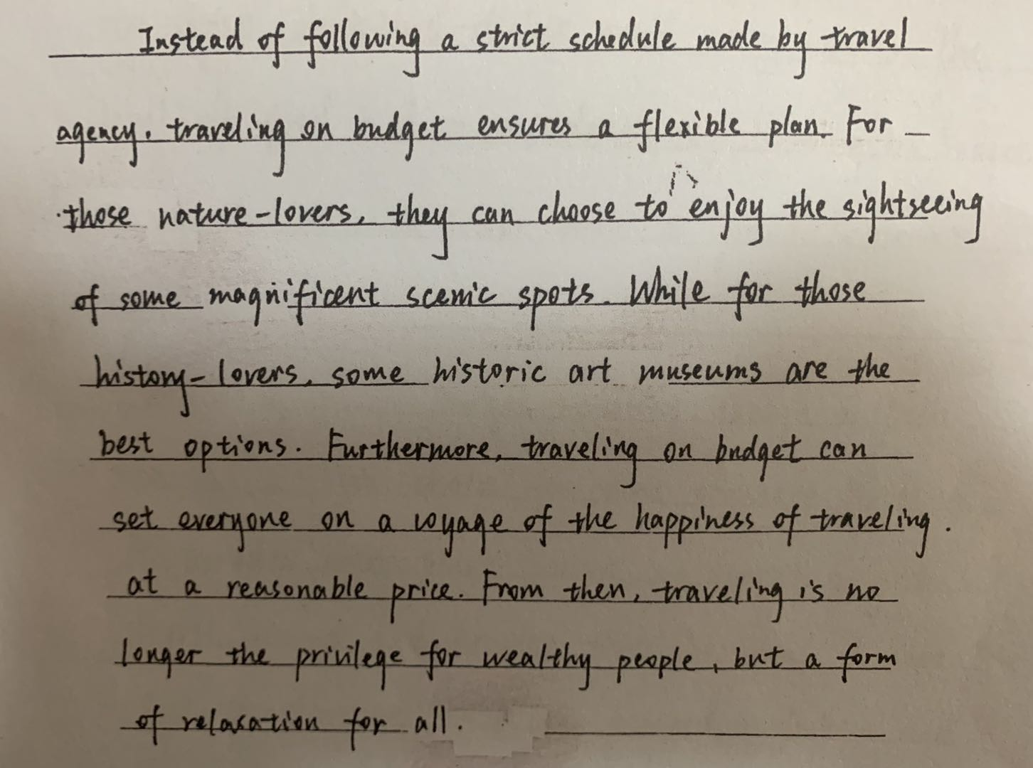

Slide 15
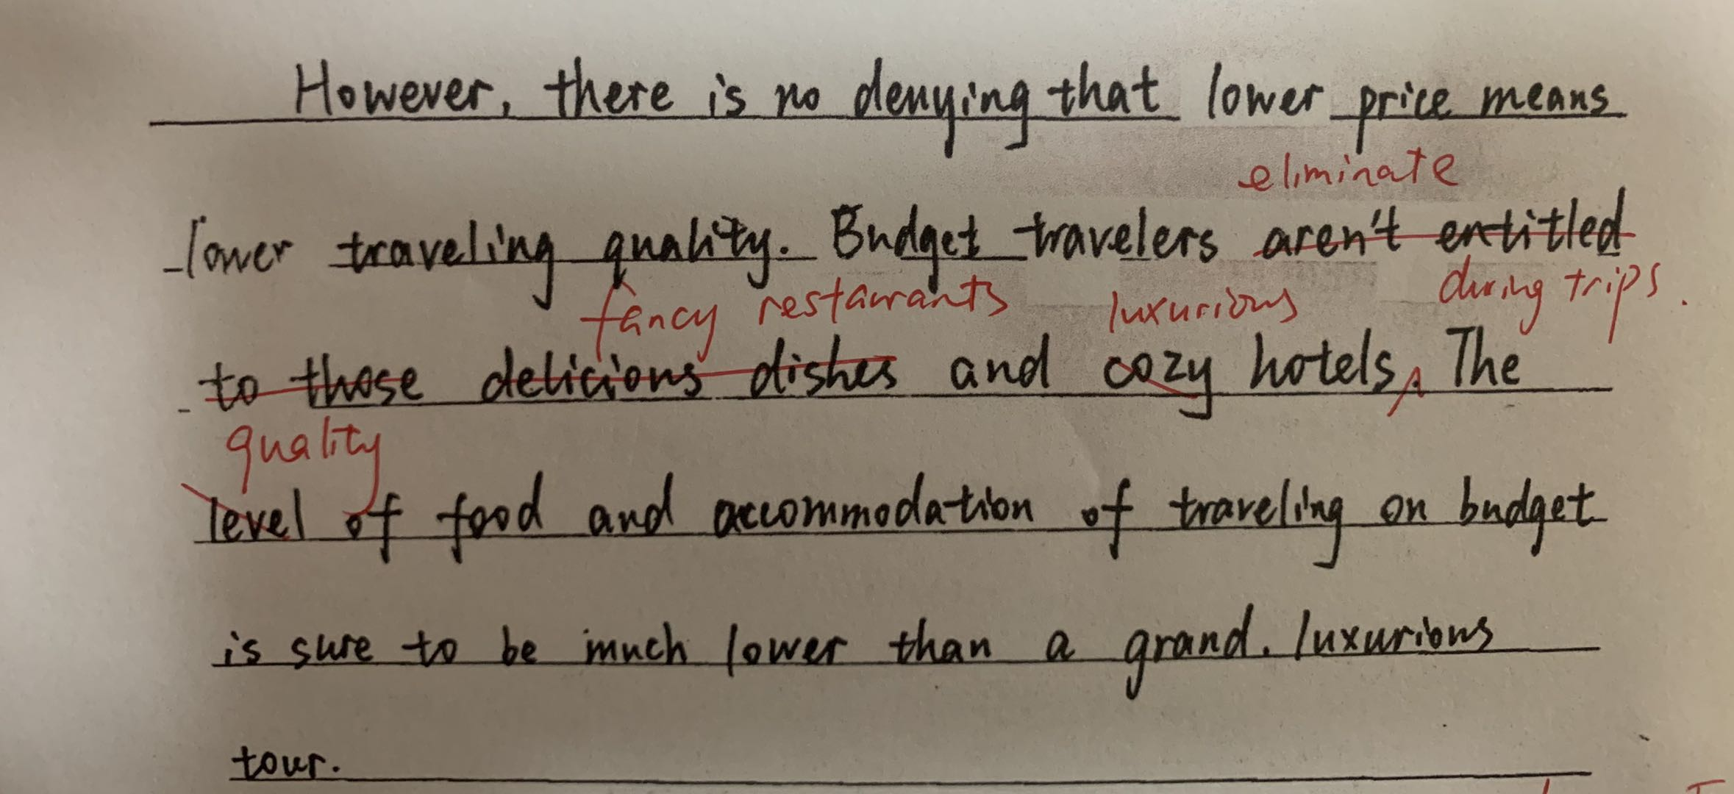

Slide 16
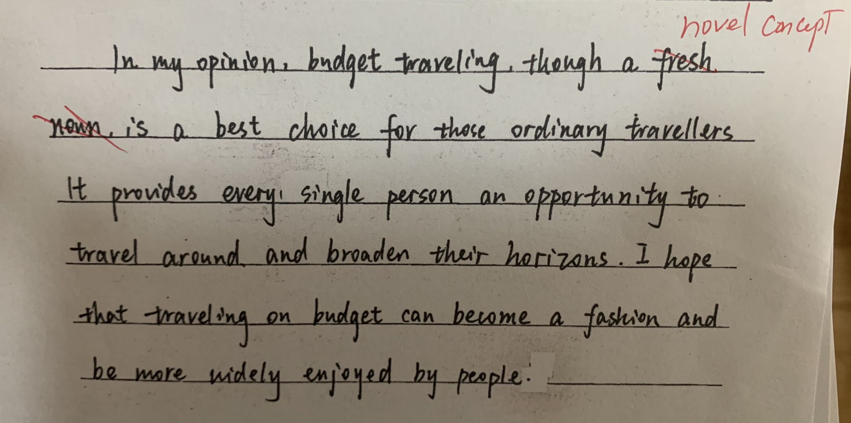

Slide 17
Joining a package tour is like wandering in a zoo, while traveling on budget is like taking adventure in a jungle. You will be pushed out of your comfort zone and meanwhile gain a deeper insight into the place you are visiting. 李凌兮
Learn to Travel, Travel to Learn
Budget travel is a deliberately chosen luxury.

Slide 18
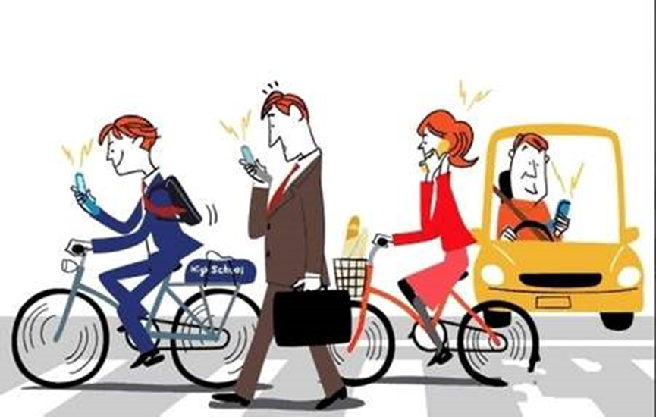
低头族(phubbing)现象的出现令人担忧，沉溺于智能手机带来了诸多危害， 1. 简要描述下图， 2. 表达你对低头族现象的看法及建议

Slide 19
smart phone/harm/worry/phubbing
description
harm
suggestion

Slide 20
picture description
1. 现实的生活场景
2. 几乎到处可见的常见场景
3. 上瘾的人
4. 难以控制/ 停不下来/传染性的（习惯 ）
5. 反映了一个令人担忧的/ 警示性的现象
6. phubbing 的意思是因为手机忽视了周围的人
7. phubbing 是一个最新创造出的词语
8. 无论是在路上还是在交通工具里，行人，骑车人，驾驶员，无一例外都…
9. 不能抑制住看手机的冲动
10. 低头/目光盯住/手指在屏幕上不停地滑动

Slide 21
Harm
1. 对…产生负面影响
2. 有潜在的危害/ 有风险
3. phubber会付出高昂的代价
4. 身体危害：
视力下降/眼睛压力/脊柱问题/睡眠时间/注意力
5. 社会危害：
对外部世界冷漠/缺少人际互动/交通安全隐患

Slide 22
Suggestion
把手机收起来
把手机放在拿不到的地方
减少不必要的app
设定固定时间用手机
找到生活中更加有意义的目标

Slide 23
replace your smartphone use with healthier activities
photo album VS artistic works in the museum
downloaded music VS ???
online games VS ???
aimless chat VS ???
surf the Internet nonstop VS ???

Slide 24
replace your smartphone use with healthier activities
photo album VS artistic works in the museum
downloaded music VS sounds in nature
online games VS sports games on the athletic fields
aimless chat VS face-to-face communication
surf the Internet nonstop VS lose yourself in a novel

Slide 25
i
Ending
1. Admittedly, smart phones __________________________.
2. Ironically, smart gadgets are meant to connect, but they end up ________________________.
3. Voices ________________ can be heard in our life.
4. Should the suggestions mentioned above be adopted/initiated, ____________________________________
___________________________________________________.

Slide 26
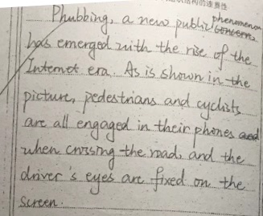

Slide 27
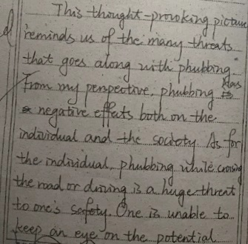
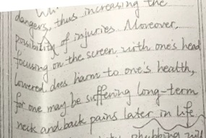

Slide 28
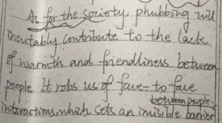

Slide 29
